Slide 1




Slide 2
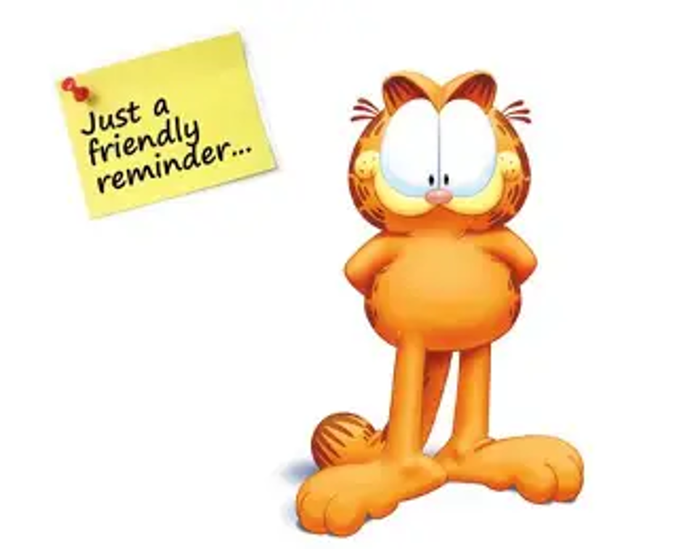
Video Club expectations:
Model good behavior at meetings
Participate in 2 PBIS videos (fall & spring)
Attend monthly meetings – if you have 2 unexcused absences, you will be removed from the club.

Slide 3
Video Club Rules
Going forward all videos must be student written and student produced in their entirety!
You MAY NOT get help from any ADULT or siblings!
Not even holding the camera!

Slide 4
PBIS Videos!!!
Great job on your PBIS videos!
Lots of animation, graphics and creativity!
We will be showing your videos on the morning news!
Things to work on… volume, location (set), lighting, follow directions

Slide 5



Slide 6

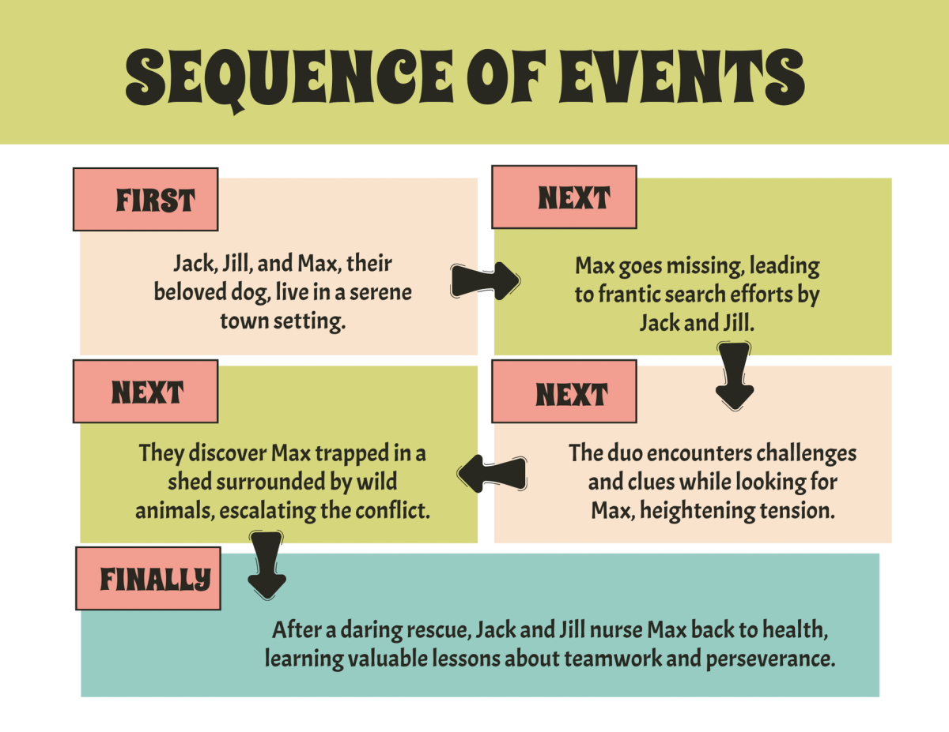
Idea
The main thing you want to show or tell in your video.
Story
The events or messages in your video, in the order that they will be shown to the viewer.

Slide 7
Script
The written words for what will be said or shown.
YOU MUST turn in a script with your Jim Harbin entry!
Storyboard
A picture plan showing each shot in your video.
YOU MUST turn in a storyboard with your Jim Harbin entry!

Slide 8
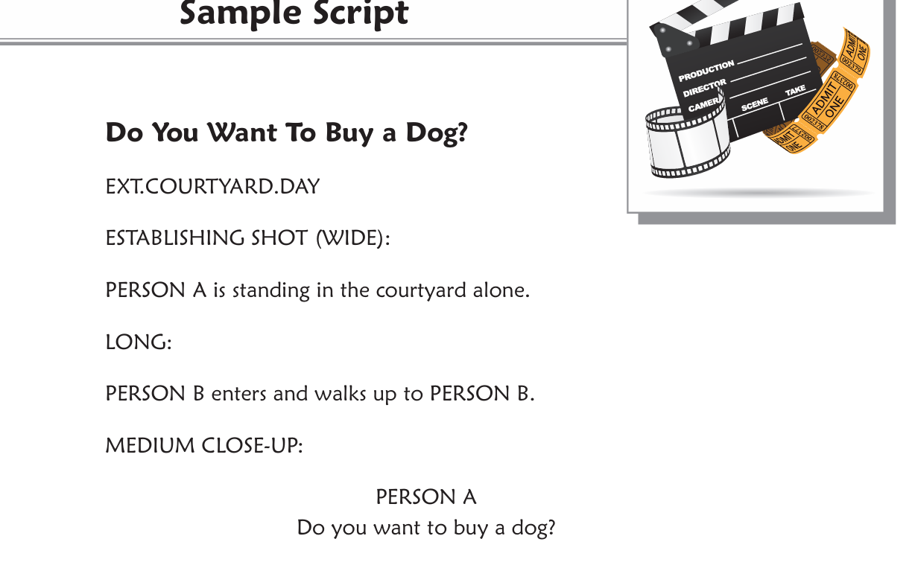
Examples of a script

Slide 9
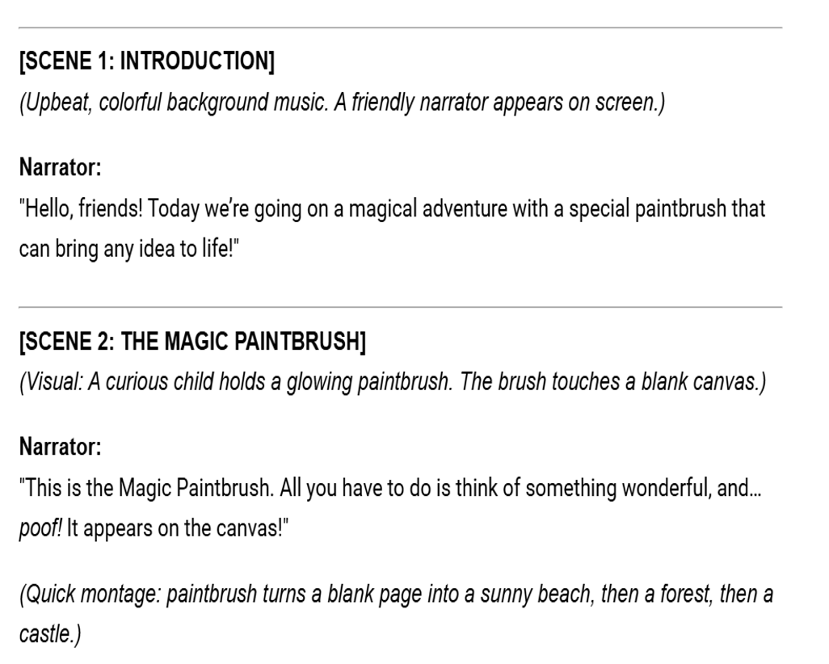
Examples of a script

Slide 10
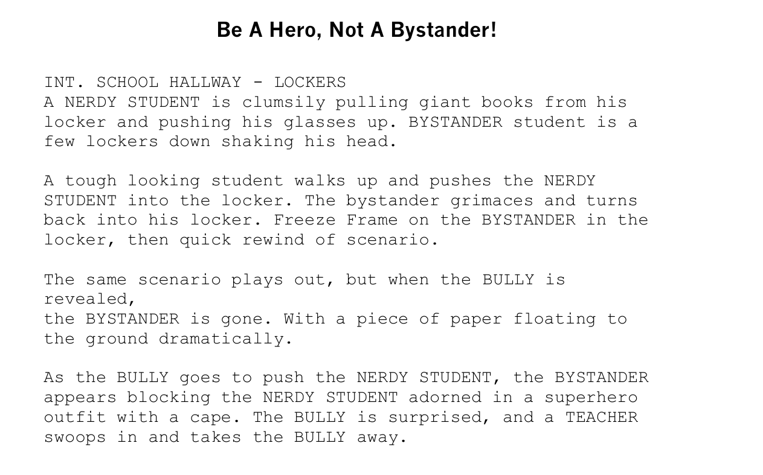
Examples of a script

Slide 11
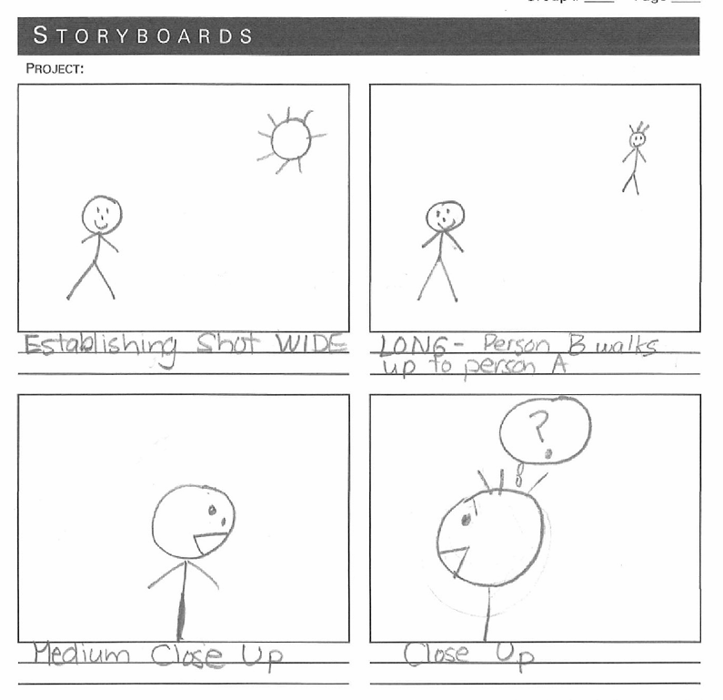
Storyboard Examples

Slide 12
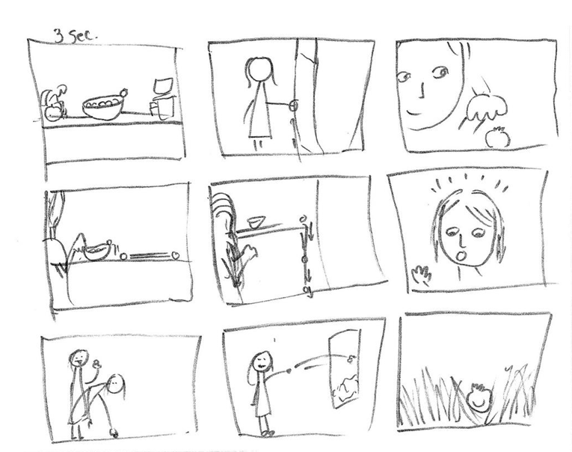
Storyboard Examples

Slide 13
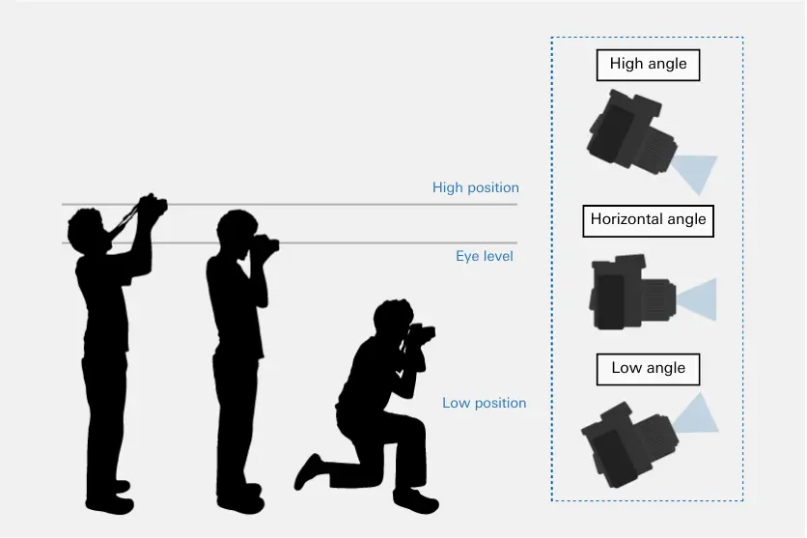
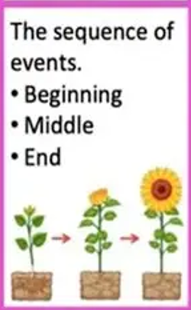
Camera angle
Where the camera is positioned (high, low, or eye level)
Plot
The order or sequence of events in your video

Slide 14
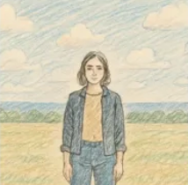
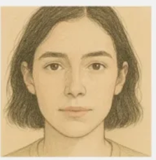
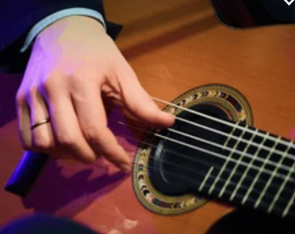
Mid shot
Shows the subject from the waist up.
Close‑up
A shot that shows only a small part of the subject (like a face).

Slide 15
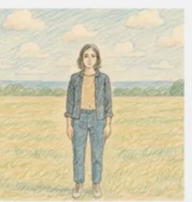
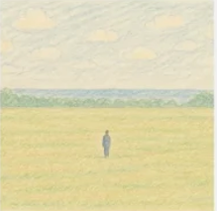
Wide shot
Camera is far away from the action. Emphasizes the environment, human subjects are not the point of the shot. Tells the viewer where the story is taking place;
Long shot
Frames the subject from the feet up or may be slightly further away to show motion. Why use it?

Slide 16

Framing
How you arrange what’s in the picture

Slide 17

Sound effect
A special sound added to make it more exciting.
Audio
The sound in your video (voice, music, effects)

Slide 18
Title
The written words that appear at the start or end of your video.
Credits
The names of the people who made the video.

Slide 19
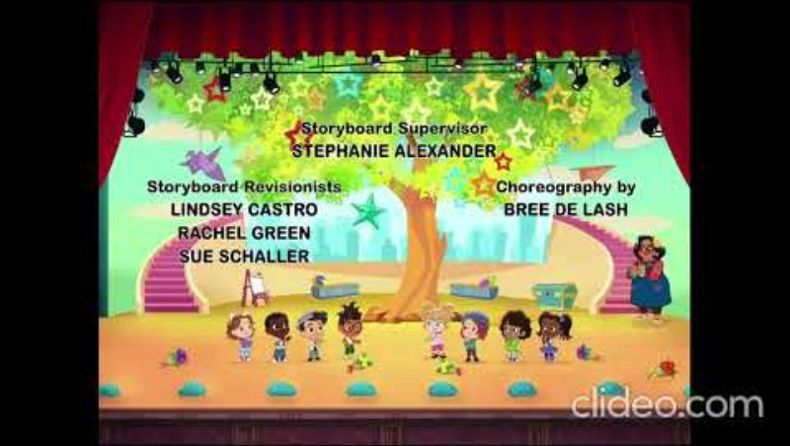

Slide 20


This is a group video project!
No individual videos
2 people minimum
5 people maximum

Slide 21
Turn in your top 3 video categories for your group Jim Harbin project.
Mr. Edeker and Mrs. Garcia will make the final decision on what category you will work on based on your topic and video subject.
7. Music Video
8. News Feature
9. News Show
10. PSA
11. Public Service Video
Jim Harbin Categories
Animation
Book Trailer
Comedy
Documentary
Drama
Instructional Video

Slide 22
Reminders:
Written copyright permission must be secured if using Legos or any other copyrighted items in your video. ESPECIALLY MUSIC!!!
Music and sound effects that are in Adobe Express are ok and you must still list your source in the credits of your video.

Slide 23
November Assignment: (see handouts)
Return your signed parent/guardian agreement
Return your signed Student Pledge
Bring your script and storyboard to the December meeting. Blank script and storyboard templates are on the website.
It does not have to be complete, but we need to see what you have planned for your video.

