Slide 1
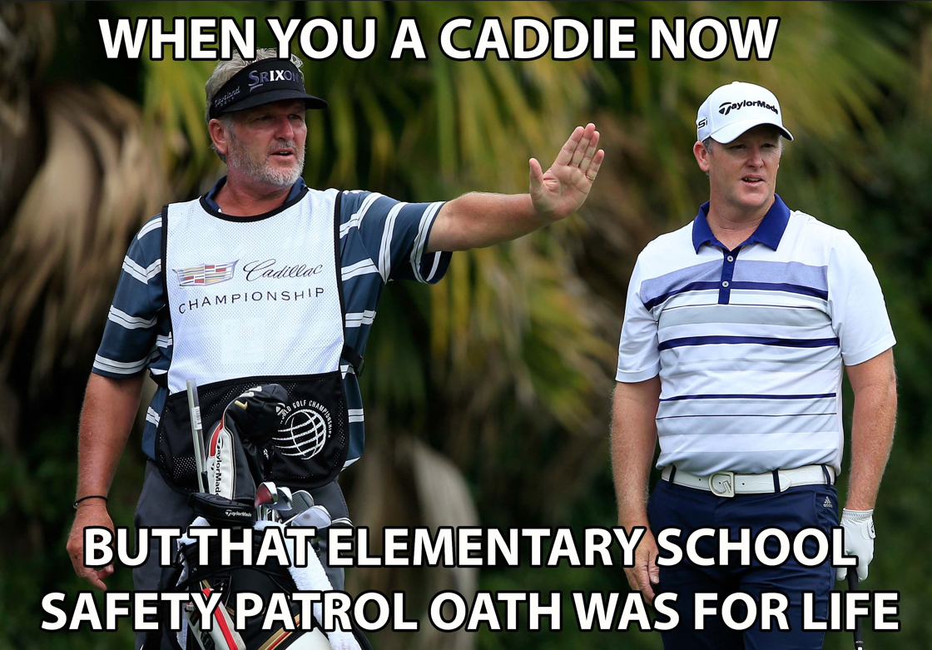
Safety Patrol Today
WE ARE GOING TO LEARN ABOUT

Slide 2
WE WILL NOT ANSWER QUESTIONS DURING THIS PRESENTATION.
WHEN YOU GET HOME, PLEASE TAKE
THE TIME TO REVIEW THE PRESENTATION AND APPLICATION PACKET.
IF YOU STILL HAVE A QUESTION, THERE WILL BE AN ONLINE LINK YOU CAN CLICK TO ASK MS. JASON YOUR QUESTION.
This Photo by Unknown Author is licensed under CC BY-NC-ND

Slide 3
THIS YEAR
Students cannot be on both the Safety Patrol team and the News Team.
Applications will first open for the Safety Patrol team. If you are interested in applying for the Safety Patrol team, YOU SHOULD DO IT! The Safety Patrol team will be chosen on April 17, 2025.
If you are not selected for the Safety Patrol team you can apply for the News Team when that application opens on April 17, 2025!
If you are only interested in the News Team, you would apply for that team when the application opens on April 17, 2025

Slide 4
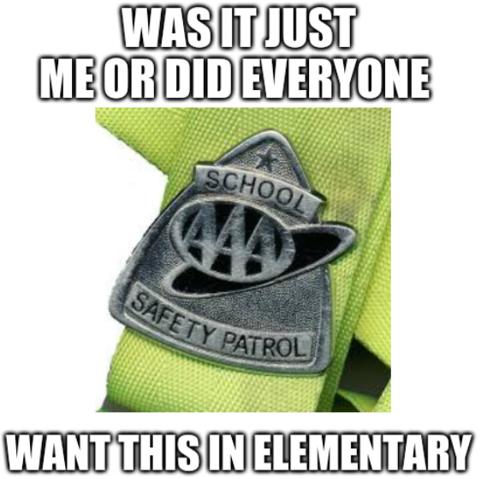
SAFETY PATROL

Slide 5
What does a Safety Patrol do?
1. Model 6 Pillars of Character every day, in classrooms, hallways, cafeteria, at ACE, on buses -.
EVERYWHERE
2. Act in a safe way and help other students and staff be safe.
3. Stay current on all your school work
and homework assignments – ALWAYS DO YOUR BEST!

Slide 6
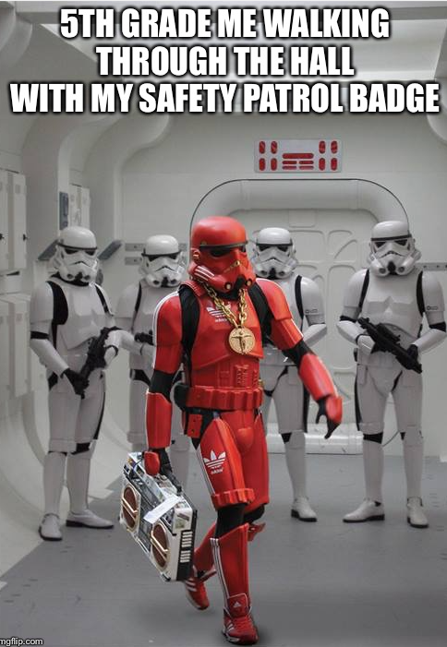
But what do they DO?
*Welcome everyone!
*Help everyone have a good morning!
*Open car doors for car riders.
*Hold doors open for students and staff.
*Help new students find their classrooms.
*Monitor hallways in PVPV Building.
*Ambassador program for new students arriving mid-year.

Slide 7
HOW DO I APPLY? COMPLETE ALL PARTS OF THE APPLICATION
AND TURN IT IN ON TIME.
Application cover sheet with parent/applicant signature
Application paragraph
Classroom teacher recommendation
Resource teacher recommendation
If you are in ACE you must have an ACE recommendation

Slide 8
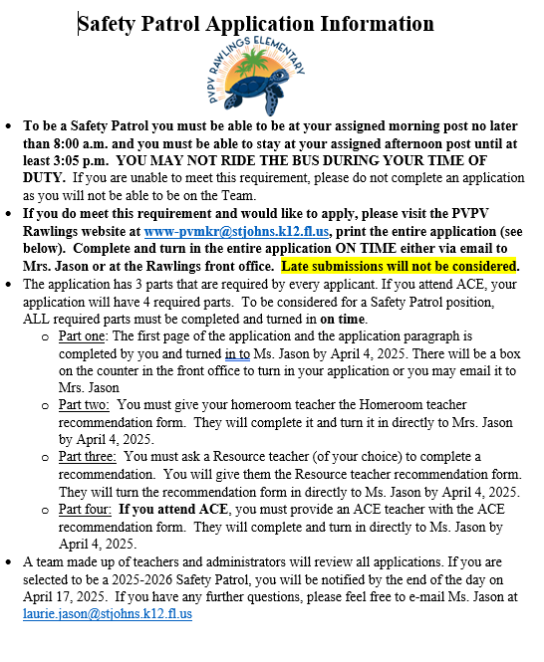
page 1 – Cover Letter
Tells you what you need to do.
Dates due.
How to contact me if you have questions.

Slide 9
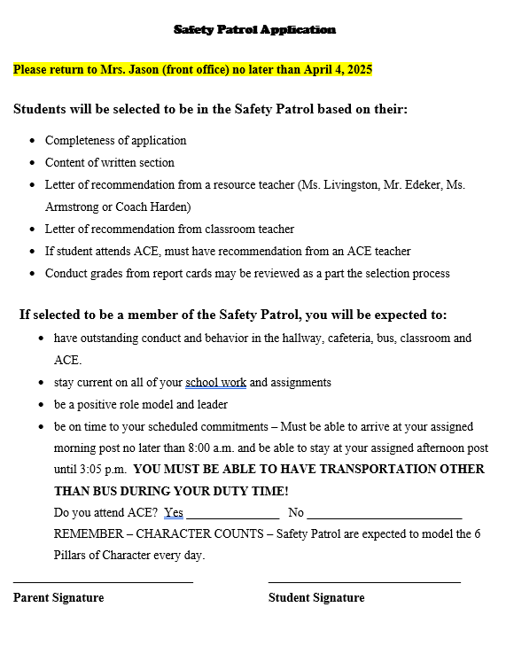
Page 2
This page MUST
Be turned in to
Ms. Jason by April 4th.
ACE question Yes/No
Parent Signature
Student Signature

Slide 10
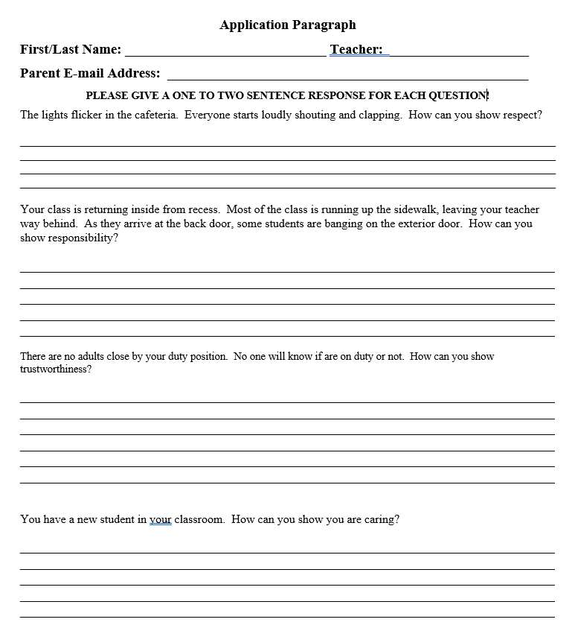
page 3
This page MUST
Be turned in to Ms. Jason by APRIL 4th.
First & Last Name
Teacher’s Name
Parent email address
Answer each question

Slide 11
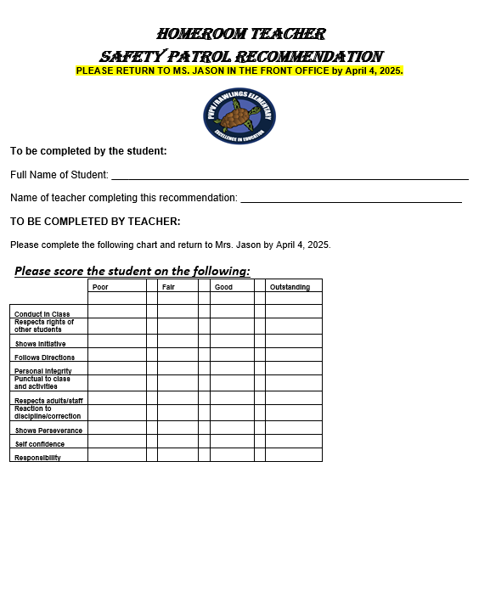
page 4
Classroom Teacher Recommendation Letter
First & Last Name
Give this page to your classroom teacher!

Slide 12
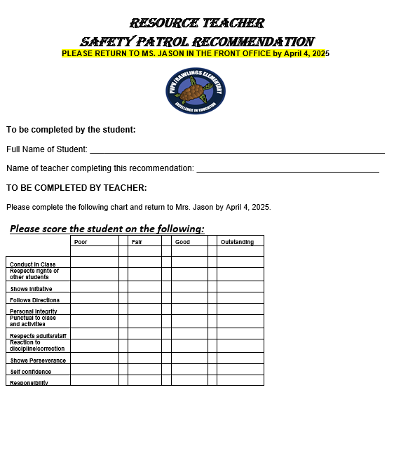
page 5
Resource Teacher Recommendation Letter
First & Last Name
Give this page to a Resource Teacher!

Slide 13
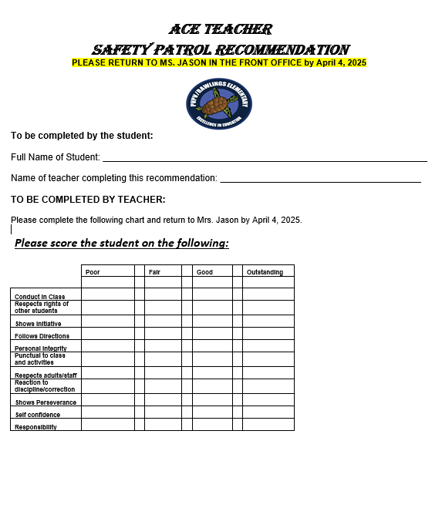
page 6
ACE Recommendation Letter
First & Last Name
Give this page to Ms. Catania or other ACE teacher!

Slide 14
FAQ’s:
How many Safety Patrol teams are there? There are two teams – A team and B team.
How do I get placed on a team? The teams are built by equally dividing students.
Can I request to be on a team with my friend or carpool buddy? We cannot accommodate any requests to place students on the same team as their friends, neighbors or carpool buddies.
How often will I be on duty? For most of the school year, the teams will alternate TWO WEEKS on duty and then TWO WEEK off duty. For example, the first two weeks of school A Team will be ON duty and B Team will be OFF duty. The following two weeks of school, B Team is on duty and A Team is OFF duty. If a school holiday or day off occurs during your week of duty, you are just off that day. The days are not made up. There are a few times throughout the year that we might switch the schedule to ONE week ON DUTY and ONE week OFF DUTY. If/when a schedule change must occur, you will be made aware of the change.
How will duty schedules be distributed? We have monthly meetings, and you will be given your new schedule at each meeting. A copy of the schedule is emailed to your parents. A copy of the schedule will always be posted on the Safety Patrol bulletin board.

Slide 15
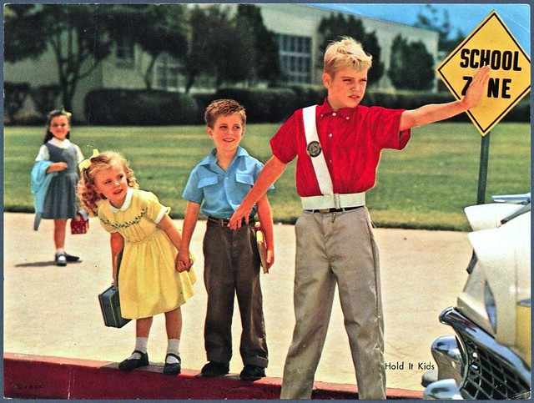
WHAT WOULD KEEP ME FROM BECOMING A SAFETY PATROL?
Application not turned in on time or incomplete.
Unable to be at your post in the morning at 8:00 a.m. and stay at afternoon post until 3:05 p.m.
Number of applicants – not everyone will be able to be selected!

Slide 16
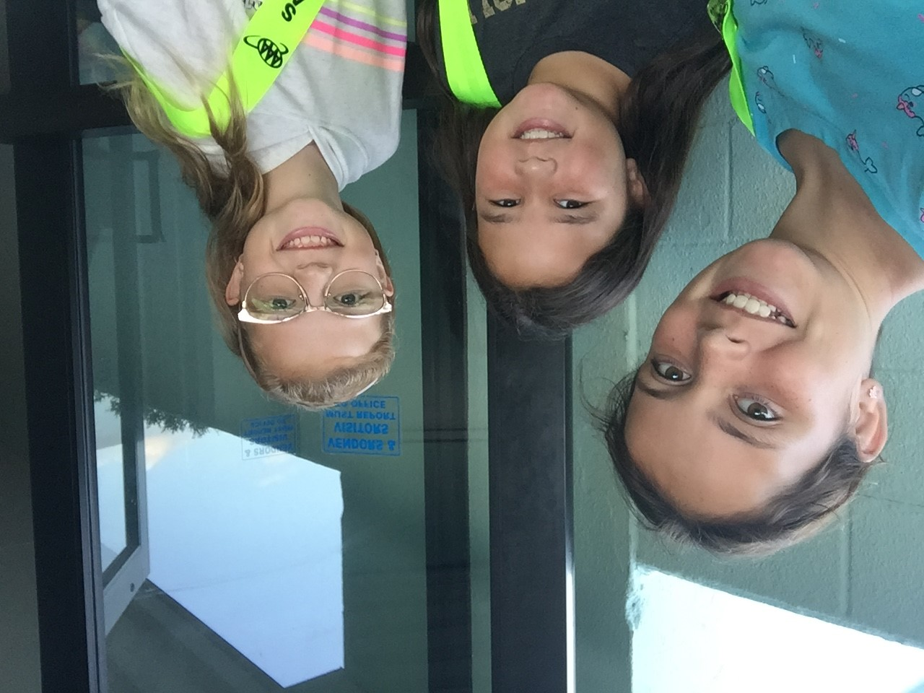
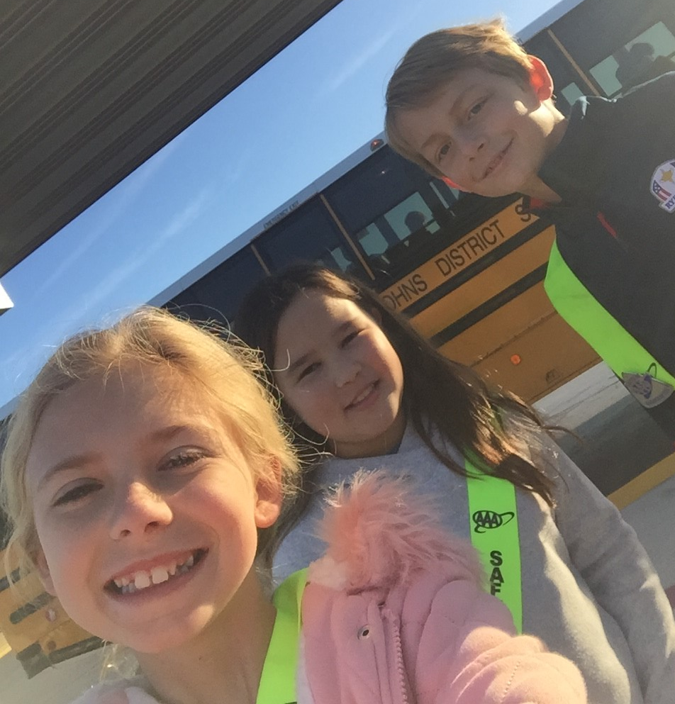

Slide 17
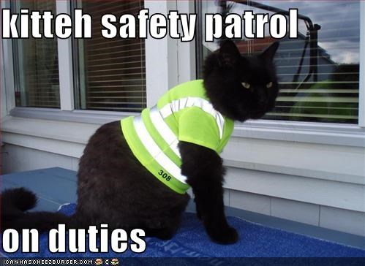
Who should apply?
ALL 4TH GRADERS!!!

Slide 18
Applications
Can be found on the school web site
Starting today!.

Slide 19
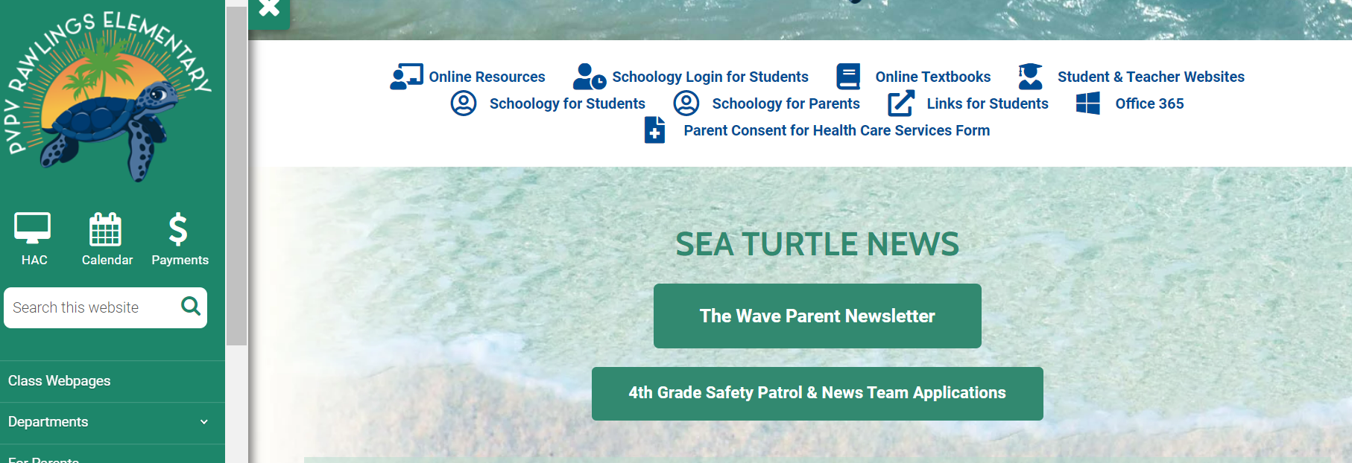
Applications are on the school web site.

